Slide 1
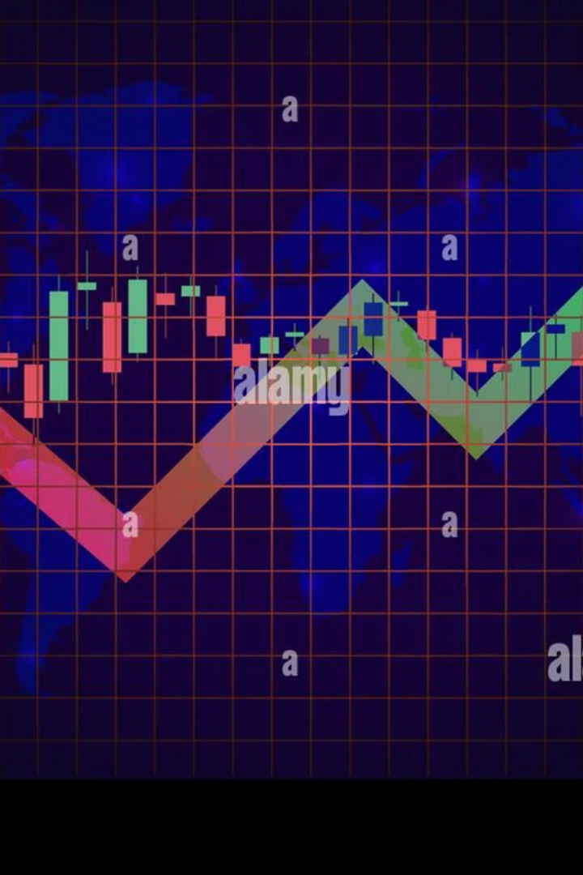
StockSense AI: Intelligent Stock Market Forecasting
Powered by AI, Time Series Models, and Market Sentiment Analysis
Presented by [Team TSM]

Slide 2
Decoding StockSense AI
AI-driven platform:
Benefits:
Time series forecasting(Testing and comparing different time series model and deep learning to train and forecast future stock value)
📈 Smarter, data-driven investment decisions
⏱️ Saves time with automated analysis
News sentiment analysis with LLMs using concept of Agentic AI(creative and reflective agents)
🧠 Expert-like AI insights from real news
📊 Accurate forecasting with clear visuals
Macroeconomic indicator insights(Ex:-Inflation Rate, Consumer Spending, etc)
🌐 All-in-one intuitive dashboard
🎓 Built-in educational resources
🔍 Transparent and explainable predictions
🚀 Ready for real-time future upgrades

Slide 3
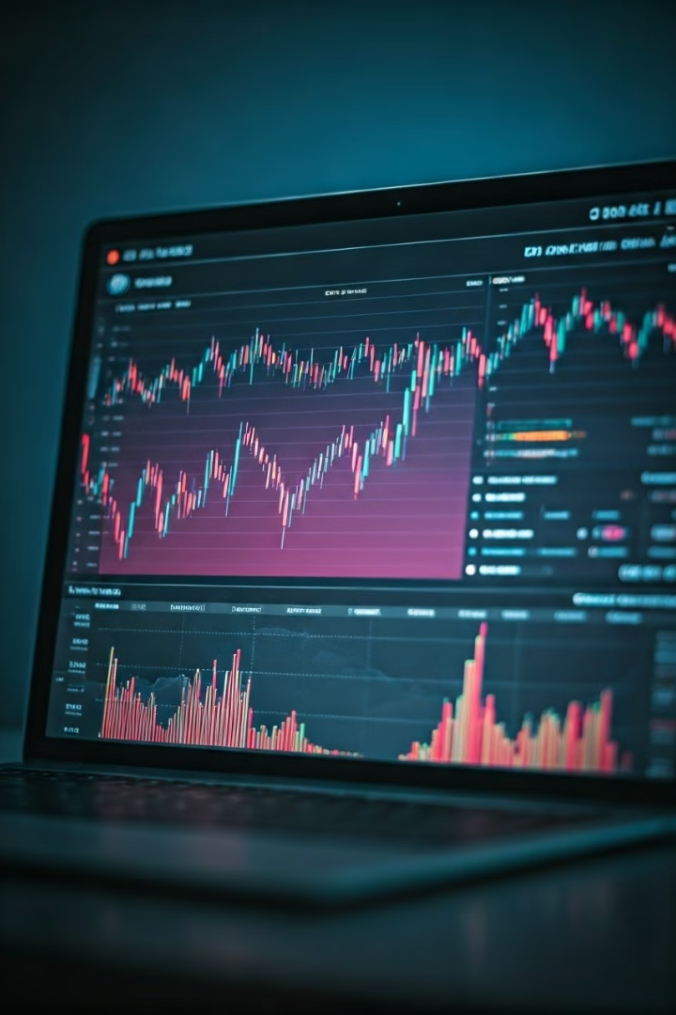
Core Features
Get Stock Data
Fetches previous year or real time data using yahoo finance,Fred
Run New Prediction
ARIMA, LSTM , CNN, Transformers forecasts and for last 30 days we test and display on our dashboard actual vs. predicted charts
AI Insights
📍 Located on the left side of the dashboard as a button
🧠 Powered by a Large Language Model (LLM) acting as a Senior Market Research Analyst
📰 Scrapes and analyzes recent news about the selected stock and market trends
📝 Provides a summary of key news events affecting the stock
Market Overview
Macroeconomic data, investment advice

Slide 4
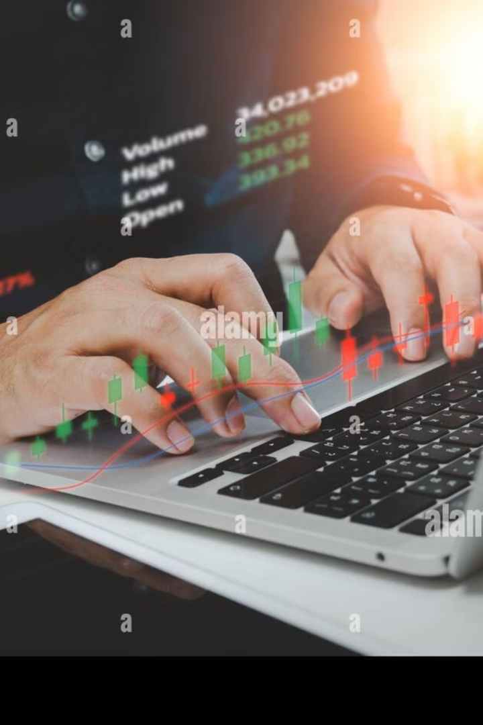



User Workflow: Step-by-Step
Enter Stock Symbol
It is a section where user have to enter the symbol of stock for which he/she wants to predict future trend or price and sentiment
Run Prediction
Click this button to get 30-day comparison + 5-day forecast and also next day stock price with chart between predicted vs actual stock price
AI Insights
📍 Located on the left side of the dashboard as a button
🧠 Powered by a Large Language Model (LLM) acting as a Senior Market Research Analyst
📰 Scrapes and analyzes recent news about the selected stock and market trends
📝 Provides a summary of key news events affecting the stock

Slide 5

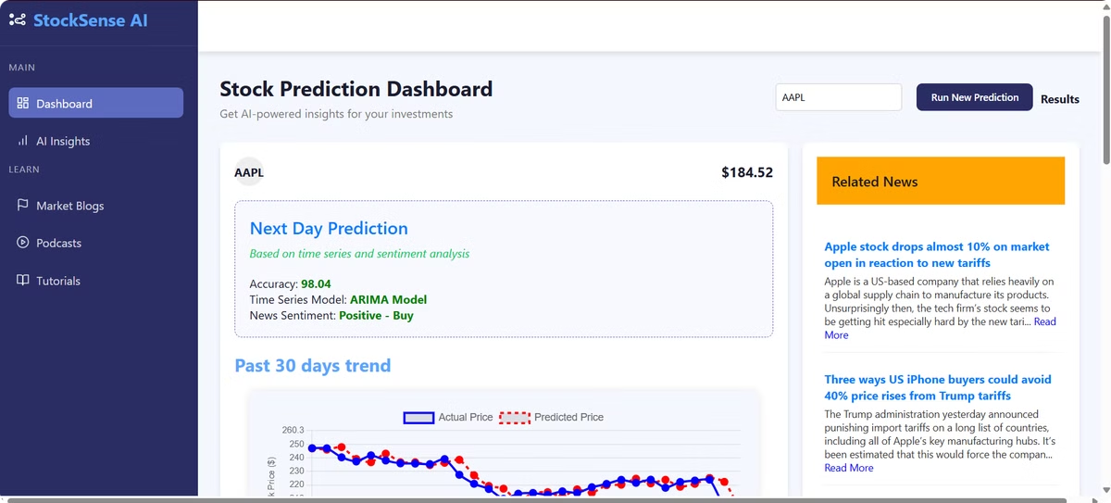




Dashboard Overview
Stock Symbol Input
Dynamic Graphs
AI Insights
Market Overview

Slide 6



5-Day Stock Price Forecast
1
Price
2
% Change
3
Auto Update

Slide 7

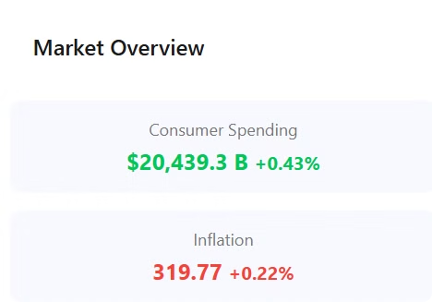
Market Overview
Macro Indicators
Trend Analysis
Interest, inflation, retail sales, unemployment
Comparison to last month
AI Insight
Brief summary, recommendation

Slide 8



AI Insights & News Sentiment
2
Sentiment Analysis
1
News Scraping
Market Mood
3
Buy | Sell | Hold

Slide 9
Educational Resources
Blogs
1
Stay ahead with expert-written blogs that explain key stock market concepts, investment strategies, technical indicators, and how AI impacts financial forecasting.
Podcasts
2
Listen to in-depth conversations with financial analysts, data scientists, and AI experts. Learn real-world use cases and how professionals interpret market trends and build data-driven strategies.
Tutorials
3
Step-by-step guides and video walkthroughs to help users understand how to use StockSense AI efficiently. Great for both beginners and advanced investors.

Slide 10

Summary: Forecast + News + Economy + Learning
Run New Prediction
AI Insights
Market Overview
Learn More
This section gives you a quick overview of the most important aspects affecting your investment:
Forecast: Get AI-powered predictions based on historical data and trends.
News: Analyze current market news and headlines with real-time sentiment scoring.
Economy: View key macroeconomic indicators like interest rates, GDP, and inflation.
Learning: Dive into blogs, podcasts, and tutorials to sharpen your knowledge.

Slide 11
Future Scope:
🔗 Real-time Social Media Sentiment Analysis: Integrate platforms like Twitter, Reddit, and StockTwits to analyze public investor sentiment live.
📺 Live News Streaming & Analysis: Use AI to summarize and interpret breaking news as it happens, impacting stock predictions instantly.
🌐 Multilingual Support: Expand accessibility by supporting multiple languages for global users.
🧠 Advanced AI Models: Incorporate transformer-based models and reinforcement learning for more accurate forecasting.
📊 Interactive Visual Analytics:

Slide 12
Big thank you!
We appreciate your time and attention.
Feel free to ask any questions
Looking forward to your feedback
Let’s shape the future of smart investing together 🚀

